Slide 1







Stack Overflow Survey
Ozma Siddiqui
August 1st,2023

Slide 2



OUTLINE
Executive Summary
Introduction
Methodology
Results
Visualization – Charts
Dashboard
Discussion
Findings & Implications
Conclusion
Appendix

Slide 3

EXECUTIVE SUMMARY
Top 10 Software Languages
Top 10 Databases
Top 10 Platforms
Top 10 Web Frames
Top 10 trending Languages next year
Top 10 trending Databases next year
Top 10 trending Web Frames next year

Slide 4

INTRODUCTION
Stack overflow Data set used as it one of the largest developer focused open collaboration platform.
Study of popular technologies used by the developer:
- Top Current Technologies
- Future Technologies
- Demographics
Trends to predict where the developers are going
Characterization of developers around the globe

Slide 5

METHODOLOGY
Collect survey data & explore its content
Web Scrapping
API
Request Library
Data Wrangling
Exploratory Data Analysis
Analyzing Data Distribution
Handling outliers
Correlations
Data Visualization
Dashboards

Slide 6
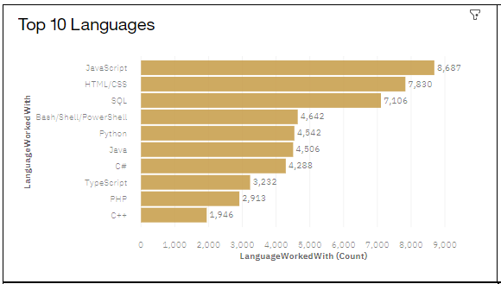
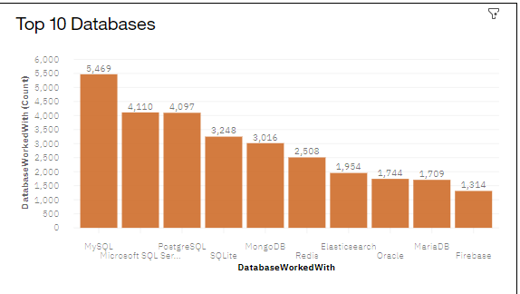
RESULTS

Slide 7
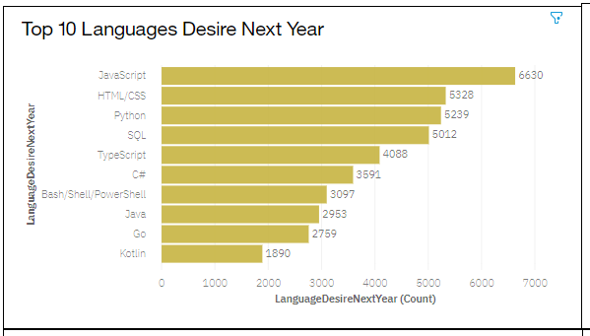
PROGRAMMING LANGUAGE TRENDS
Current Year
Next Year
<Bar chart of top 10 programming languages for the current year goes here.>
< Bar chart of top 10 programming languages for the next year goes here.>

Slide 8
PROGRAMMING LANGUAGE TRENDS - FINDINGS & IMPLICATIONS
Findings
JavaScript is no 1 language and the most desired language
HTML /CSS is at the second position followed by SQL and Python
Python and Typescript is fastest growing languages
Implications
C# and Go is becoming popular
SQL is becoming less popular
SQL and Bash skills demand is decreasing

Slide 9
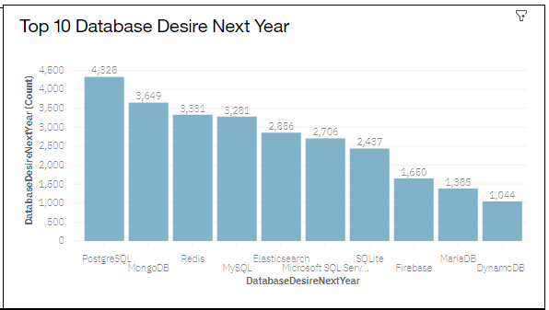
DATABASE TRENDS
Current Year
Next Year
< Bar chart of top 10 databases for the current year goes here >
< Bar chart of top 10 databases for the next year goes here.>

Slide 10
DATABASE TRENDS - FINDINGS & IMPLICATIONS
Findings
My SQL is most used data base
PostgreSQL is most desired database for next year
Implications
Microsoft SQL Server and Sqlite is losing ground in the market
Mongo DB has increased in popularity

Slide 11

DASHBOARD
https://dataplatform.cloud.ibm.com/dashboards/5e817415-c859-492d-836c-fed5a89d8741/view/5528e42b2cbd30d451f2eee4079b2f042961250eb7bbd206808c7b4909662597f36f1ac0c82f4d5b8e195162a7e947589d

Slide 12
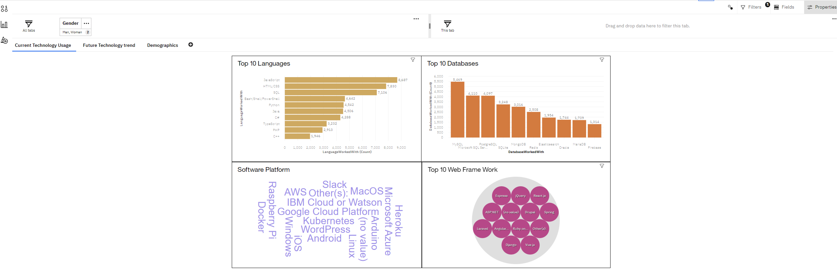
DASHBOARD TAB 1
Screenshot of dashboard tab 1 goes here

Slide 13
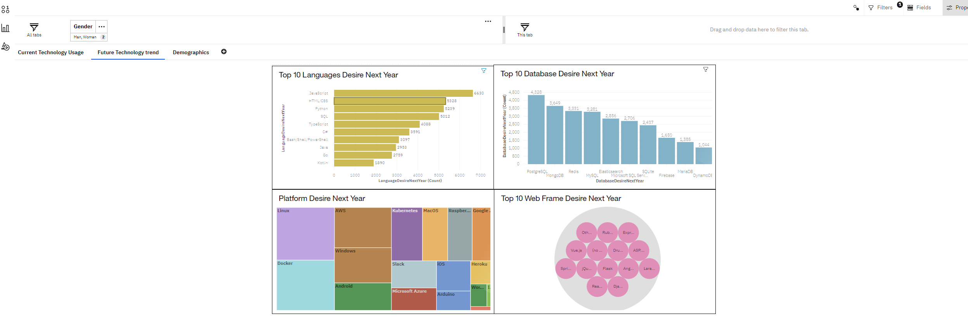
DASHBOARD TAB 2
Screenshot of dashboard tab 2 goes here

Slide 14
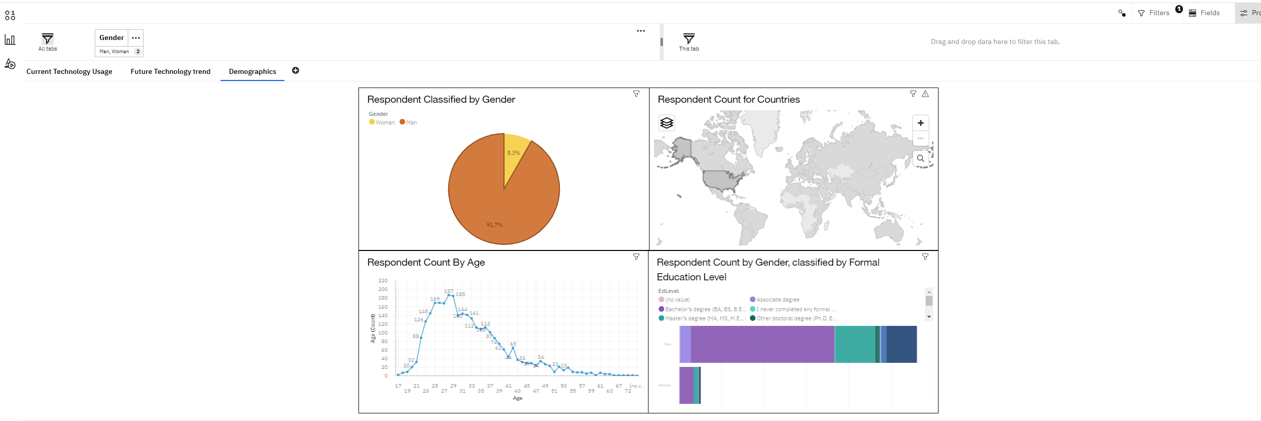
DASHBOARD TAB 3
Screenshot of dashboard tab 3 goes here

Slide 15
DISCUSSION
Data was provided in csv format
Data converted into excel format to clean and analyze data
Cognos Analytics is used to visualize the data

Slide 16
OVERALL FINDINGS & IMPLICATIONS
Findings
JavaScript is widely used, and TypeScript is getting popular
Most of the respondent were Men
Developers are mostly located in developed countries
Implications
Docker is going to be the most used platform for the next year
PostgreSQL will be most used database in next year

Slide 17

CONCLUSION
JavaScript is the most used language and will remain at the same spot in the next year too
MySQL is most used database currently, but PostgreSQL will acquire the spot of MySQL next year
Linux is the most used platform now

Slide 18
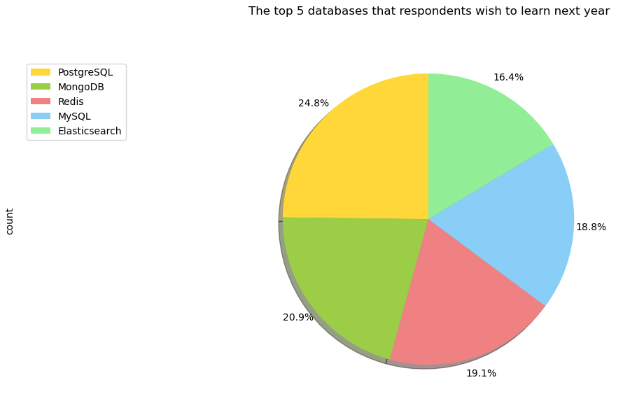
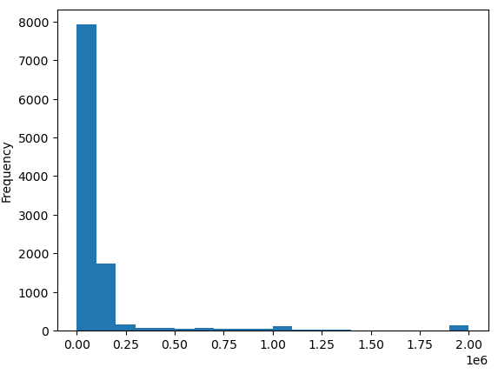
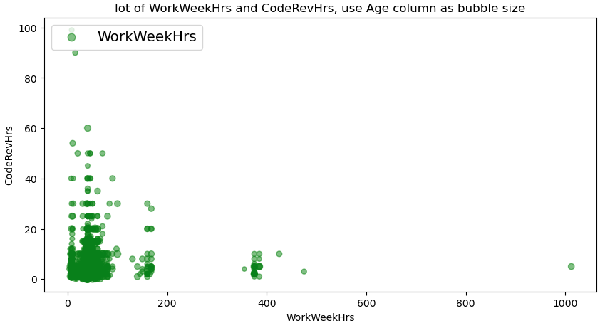
APPENDIX
Relevant additional
charts
Include any relevant additional charts, or tables that you may have created during the analysis phase.

Slide 19
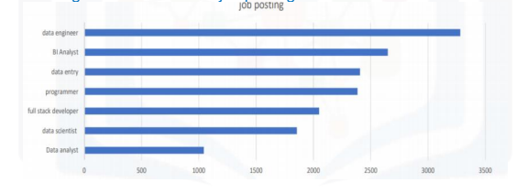
JOB POSTINGS
In Module 1 you have collected the job posting data using Job API in a file named “job-postings.xlsx”. Present that data using a bar chart here. Order the bar chart in the descending order of the number of job postings.

Slide 20
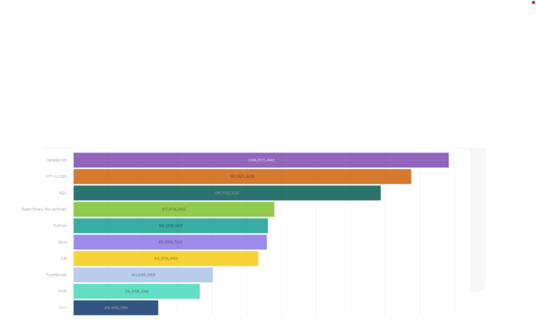
POPULAR LANGUAGES
In Module 1 you have collected the job postings data using web scraping in a file named “popular-languages.csv”. Present that data using a bar chart here. Order the bar chart in the descending order of salary.

